Slide 1
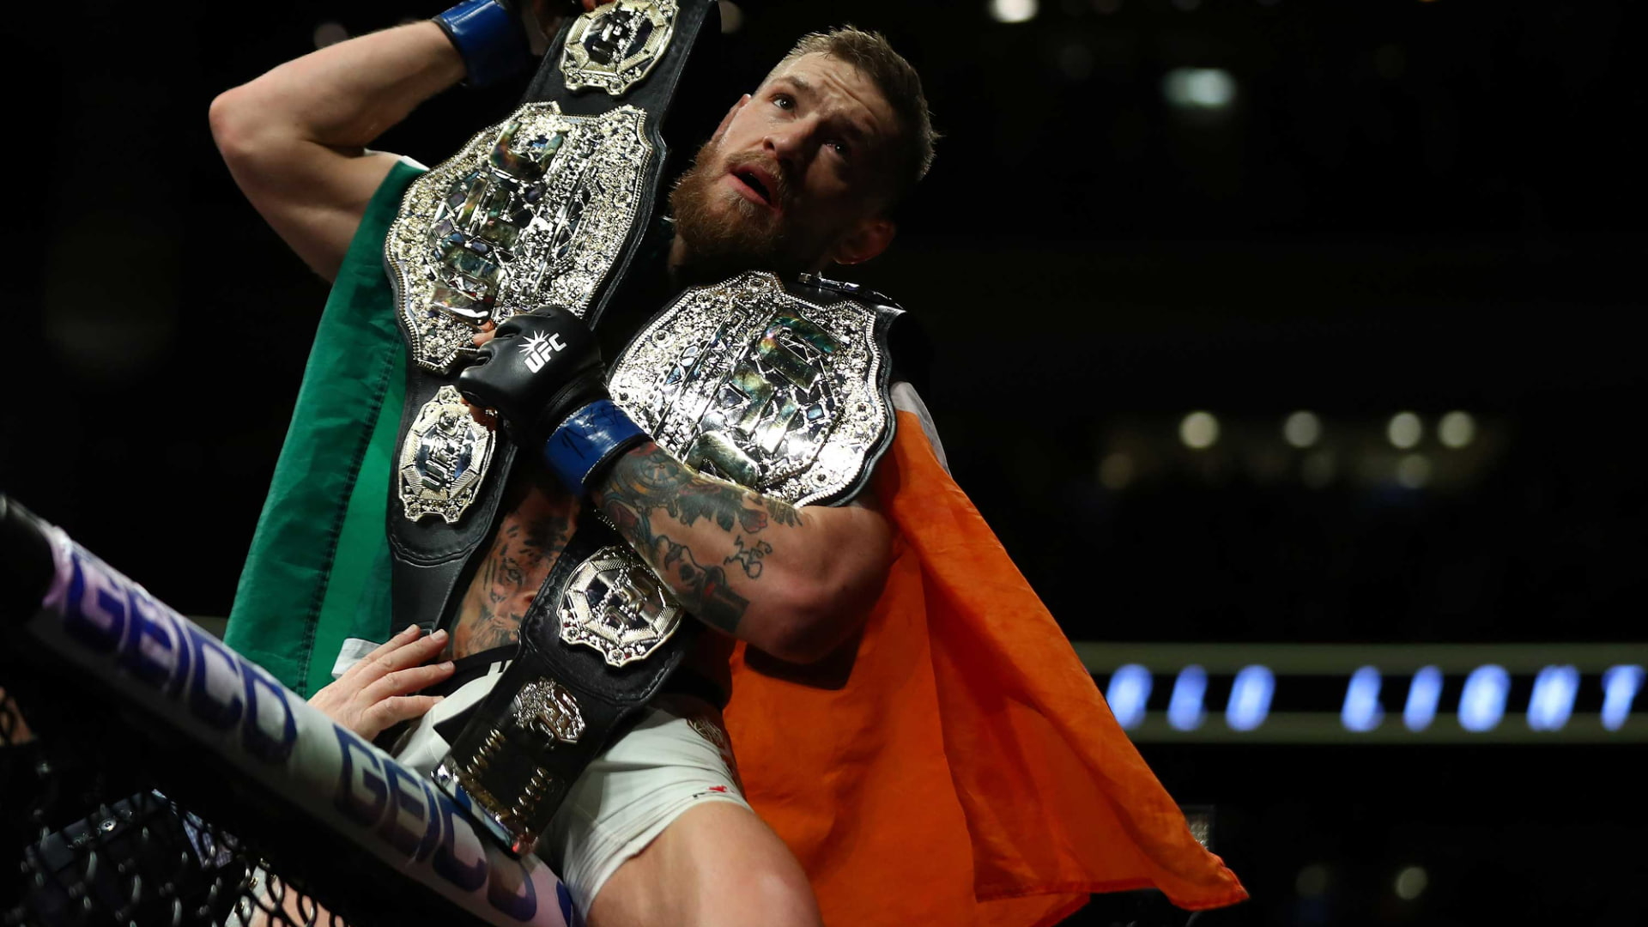

Optimize UFC fight for betting
List of tools / technologies used in this project
NumPy
Pandas
Matplotlib
SkLearn
Streamlit

Slide 2
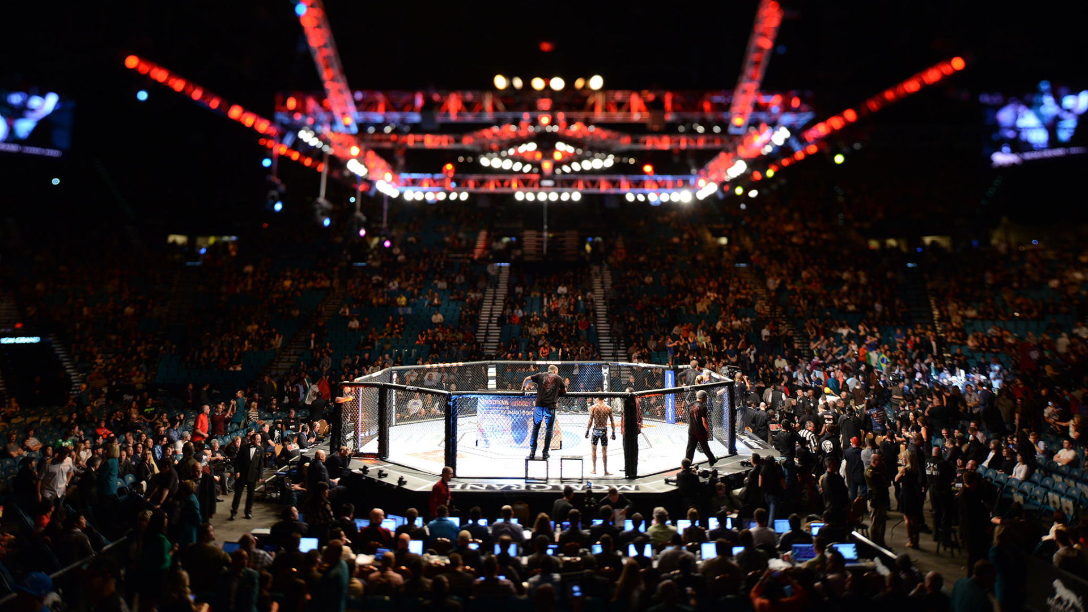
What is UFC ?
UFC stands for the Ultimate Fighting Championship. It is an American mixed martial arts (MMA) promotion company and the largest and most well-known MMA organization in the world.
The fights take place under a set of rules that allow various fighting techniques, including striking (punches, kicks, clinch, and elbows) and grappling (wrestling and submissions).

Slide 3
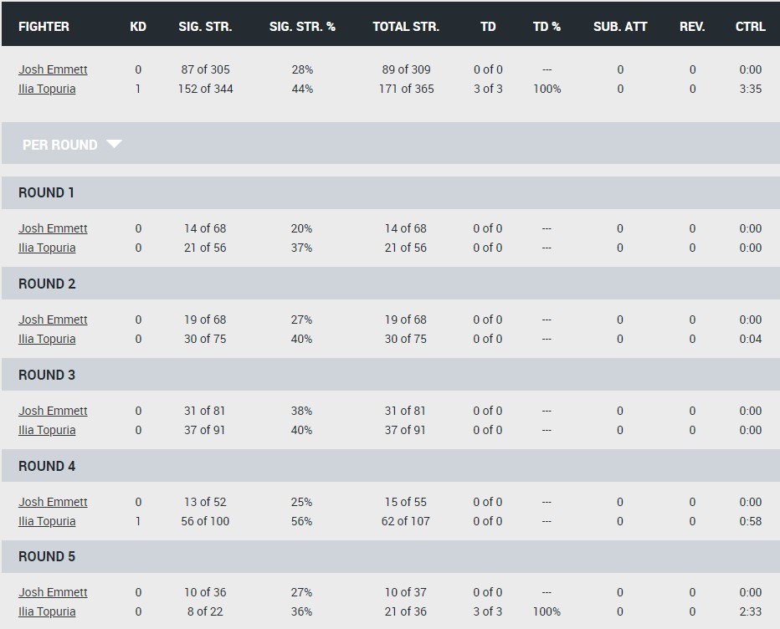
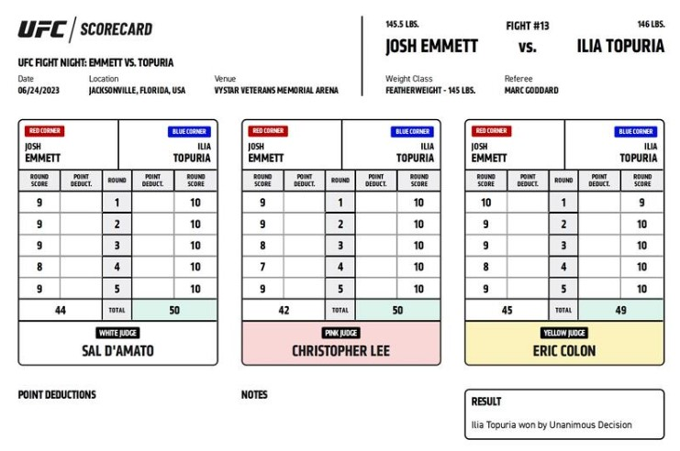
UFC judges score scheme

Slide 4
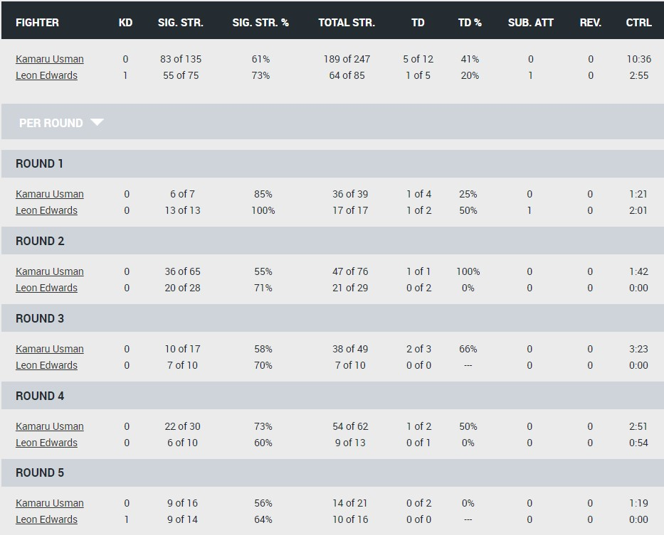
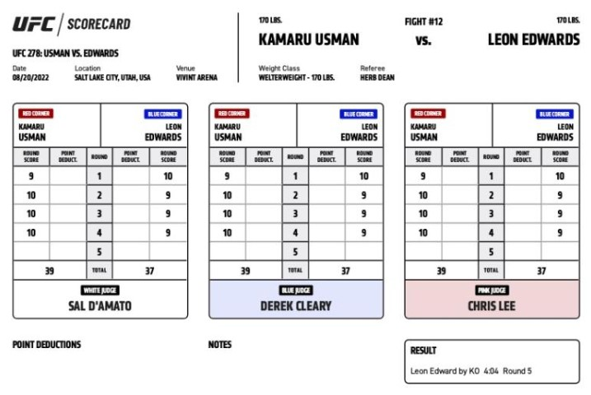
UFC judges score scheme

Slide 5
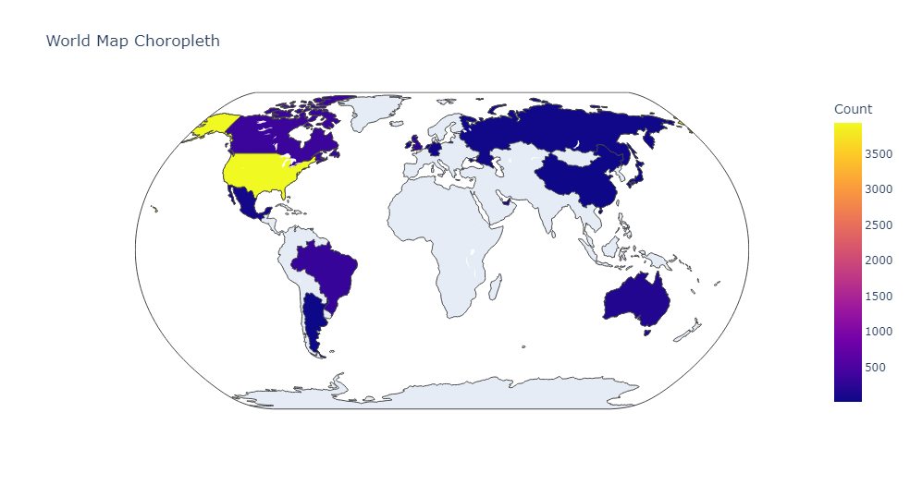
Countries of hosting UFC
Canada – 365
Brazil – 333
UK – 255
Australia – 173
Mexico - 72

Slide 6
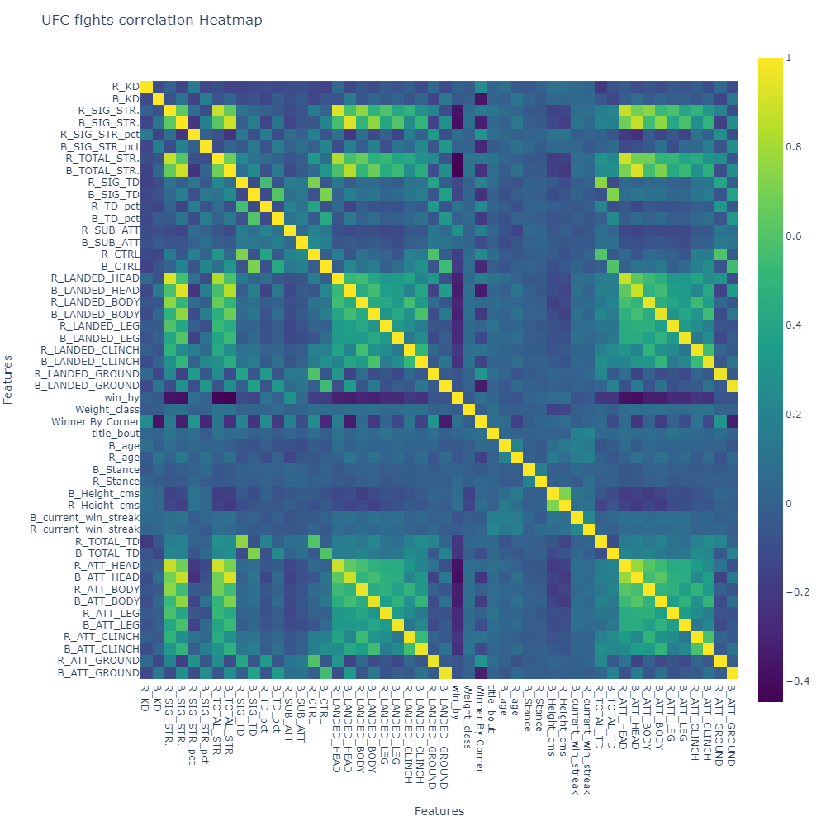
Correlation Heatmap

Slide 7
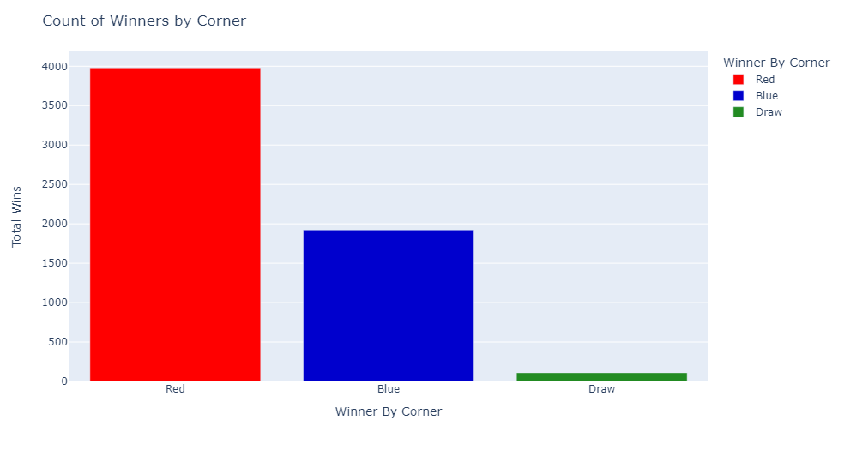
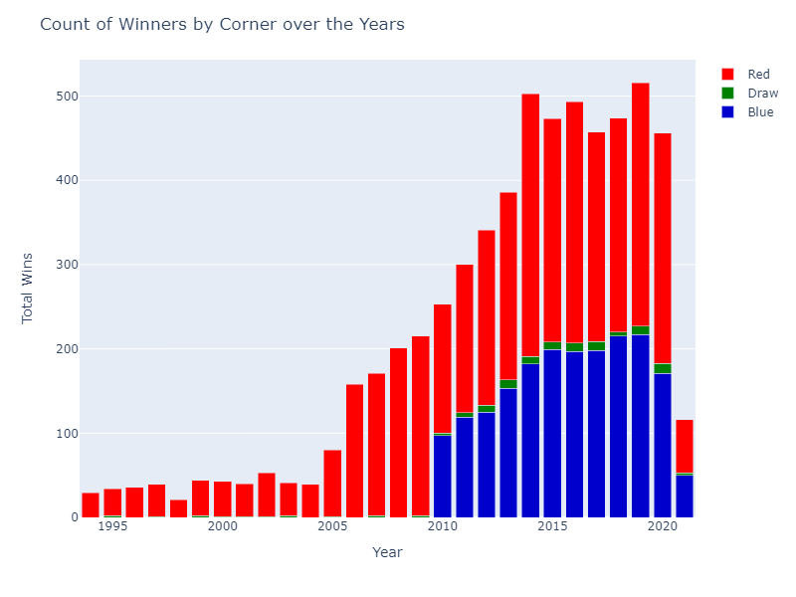
Winners by corner

Slide 8
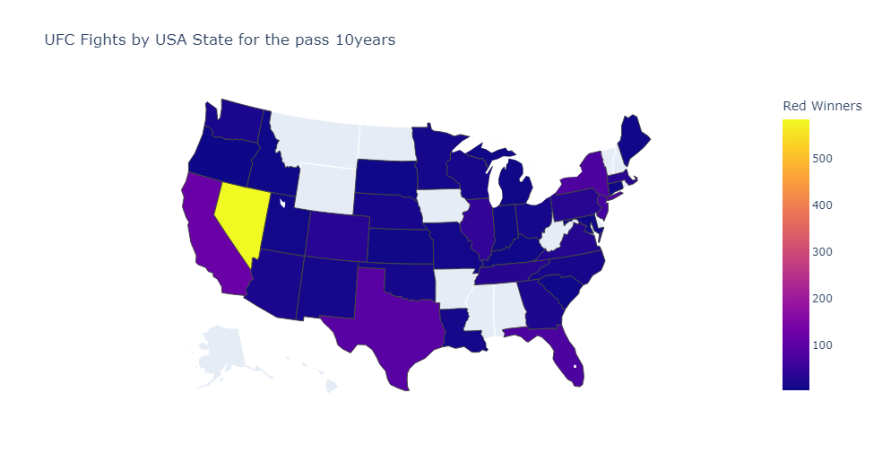
UFC fights by USA states
Nevada - Red 586 / Blue 411
California - Red 121 / Blue 92
Texas - Red 97 / Blue 78
New York - Red 80 / Blue 59
Florida - Red 79 / Blue 69

Slide 9
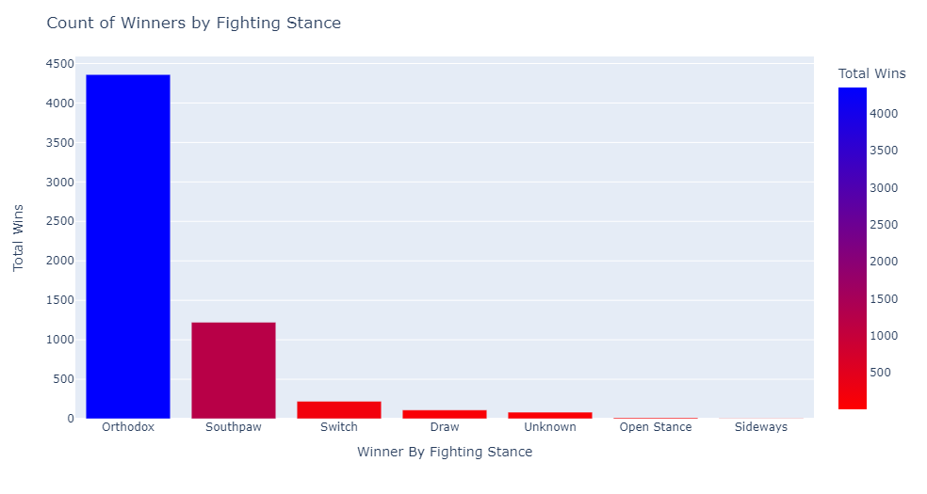
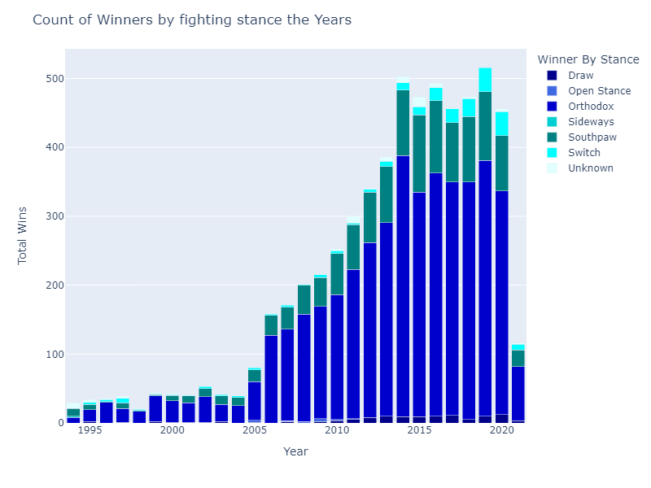
Winners by fighting stance

Slide 10
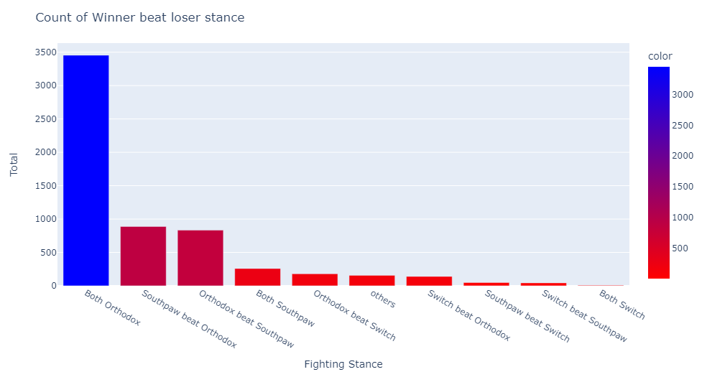
Winners by fighting stance

Slide 11
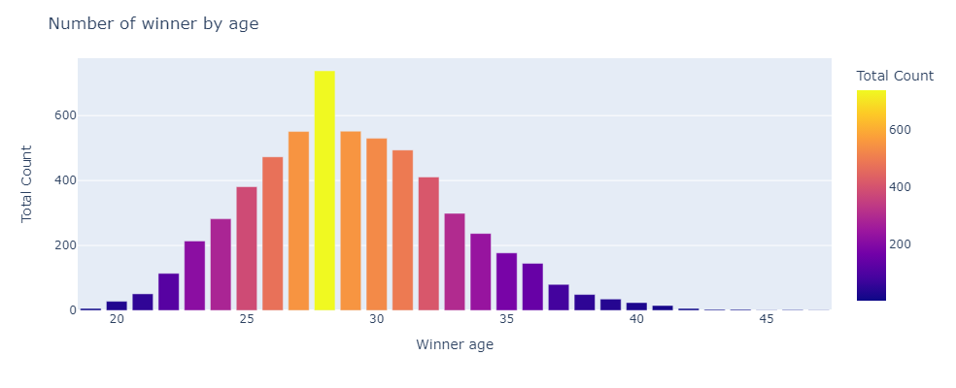
Winners by age

Slide 12
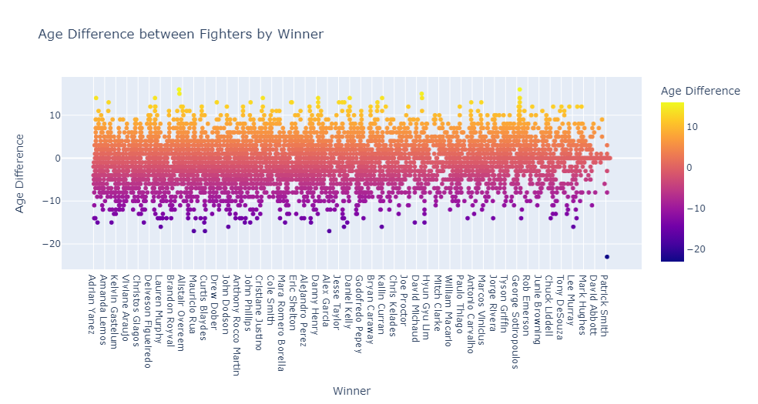
Winners age difference

Slide 13
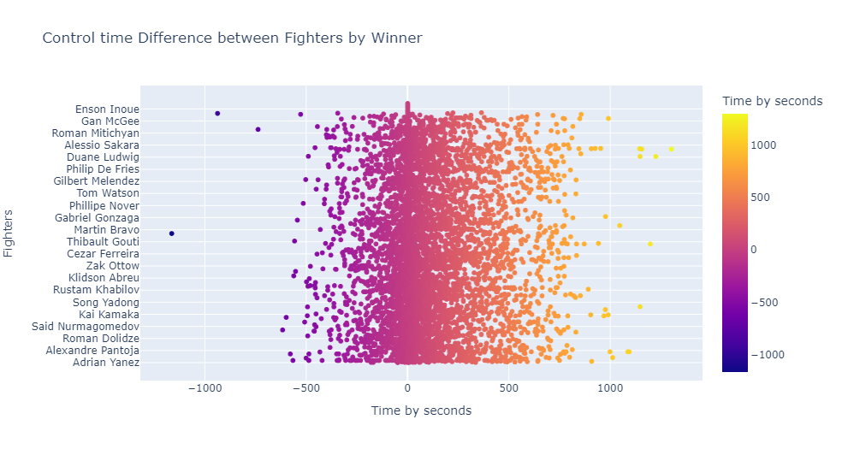
Winners control time difference

Slide 14
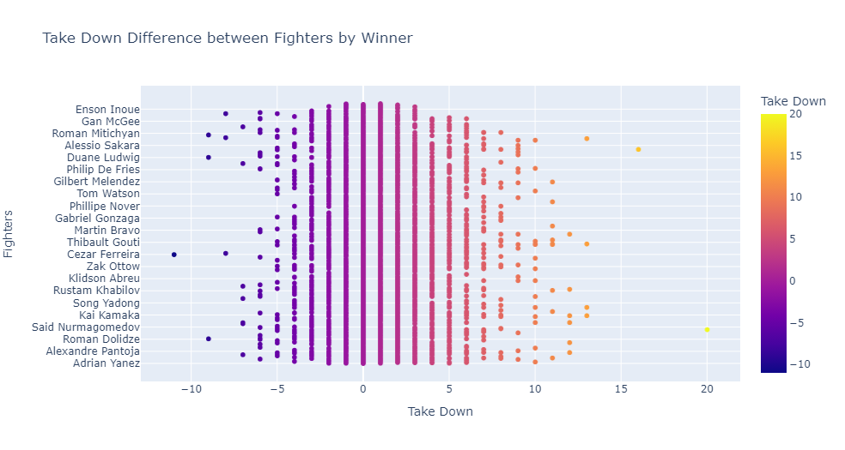
Winners take down times difference

Slide 15
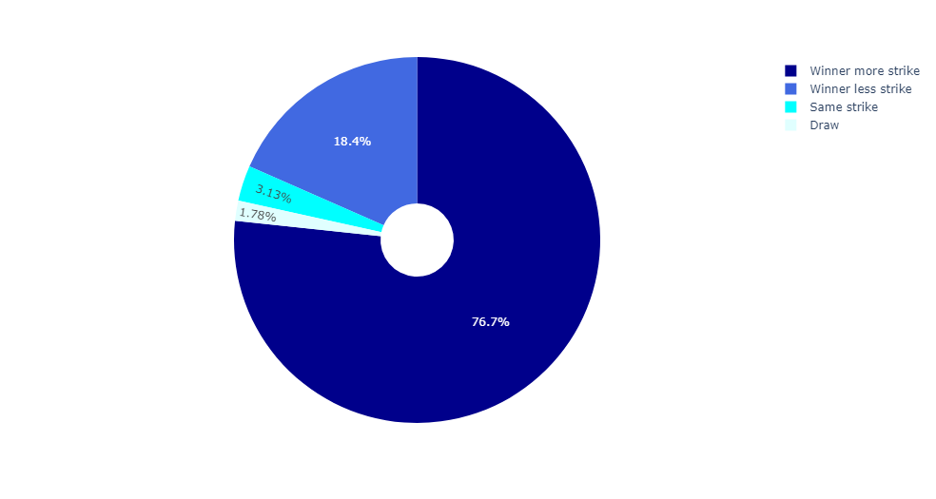
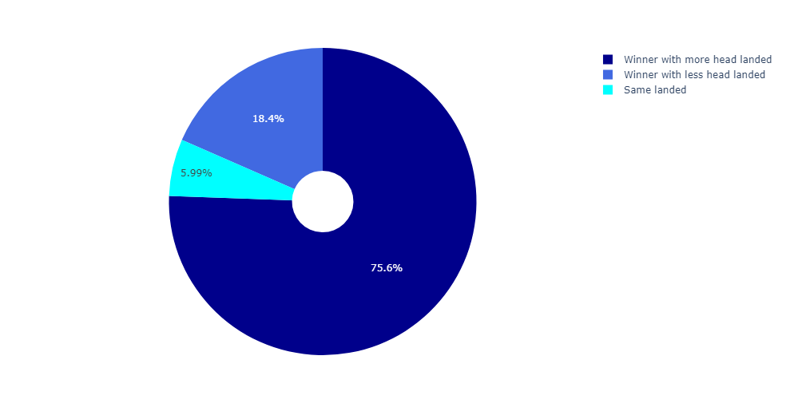
Striking and Head landed

Slide 16
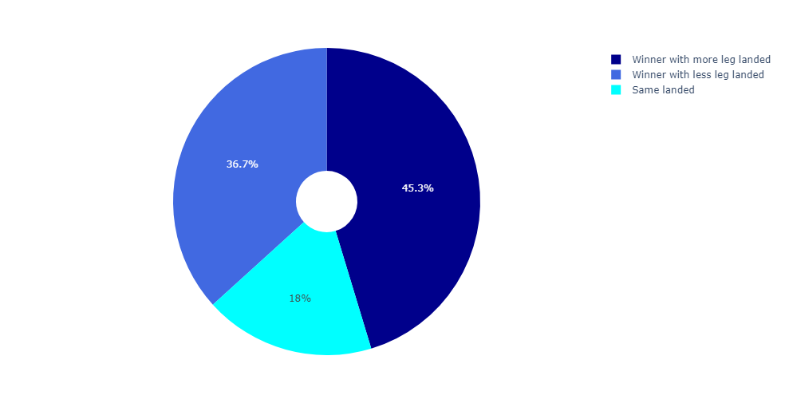
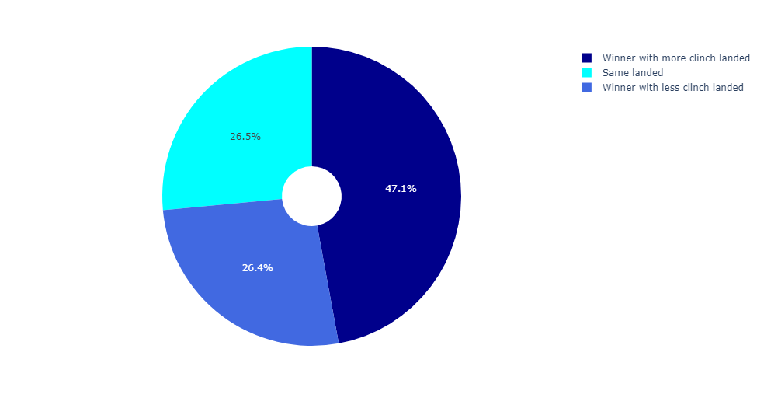
Leg landed and Clinch landed

Slide 17
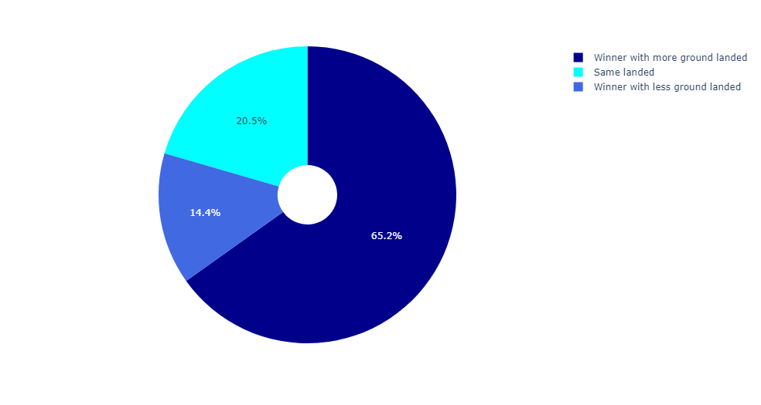
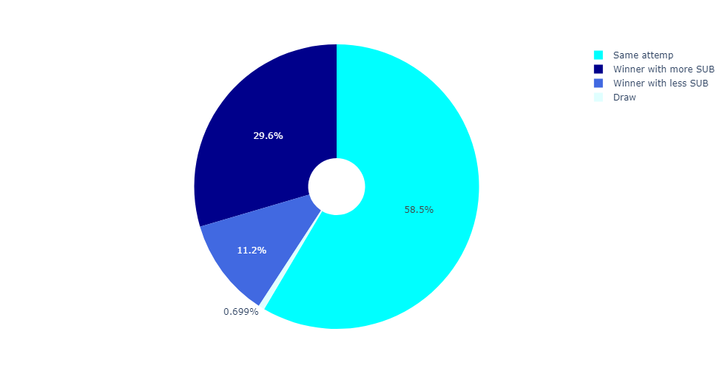
On ground landed and Submission

Slide 18
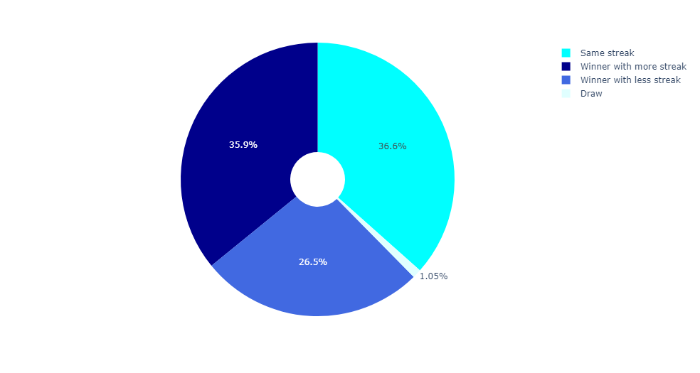
Winner with more current winning streak

Slide 19
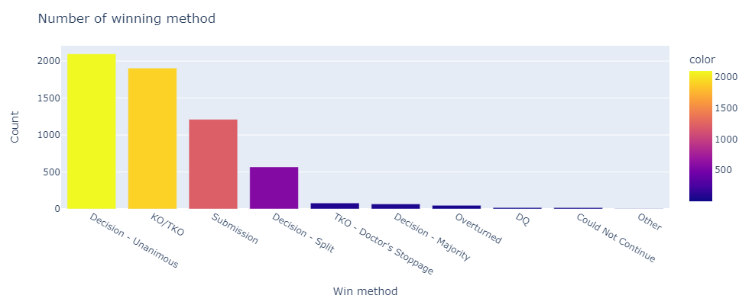
Winner by winning method

Slide 20
Conclusion
We can predict the fight base the tactics from the graph showing
Important | Not Important
Striking Skills | Age
Control Times | Fighter Corner
Take Down | Fighting Stance
Winning Method (KO/Submission) | Wining Streak

Slide 21
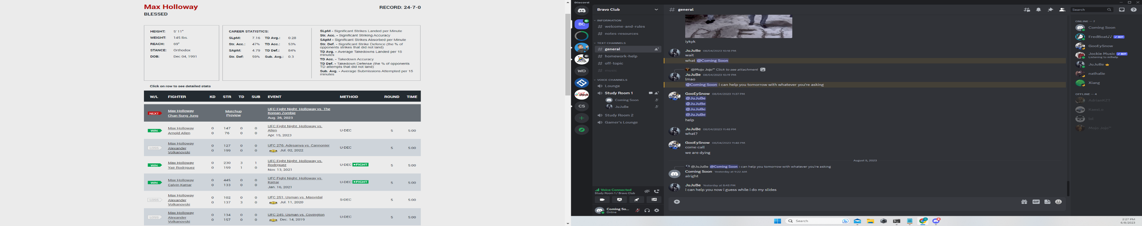
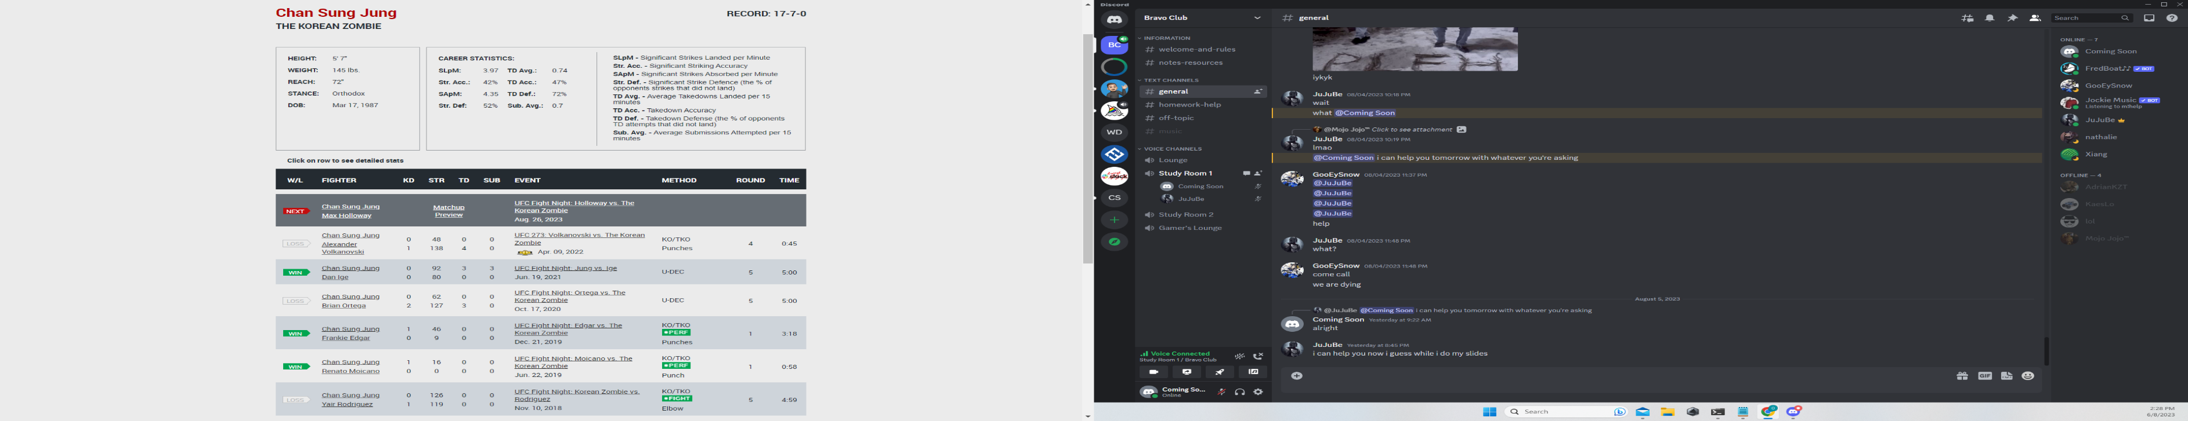
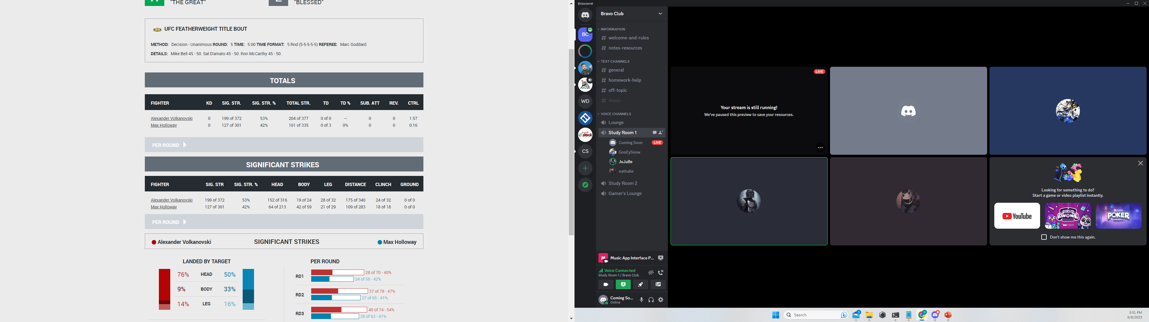
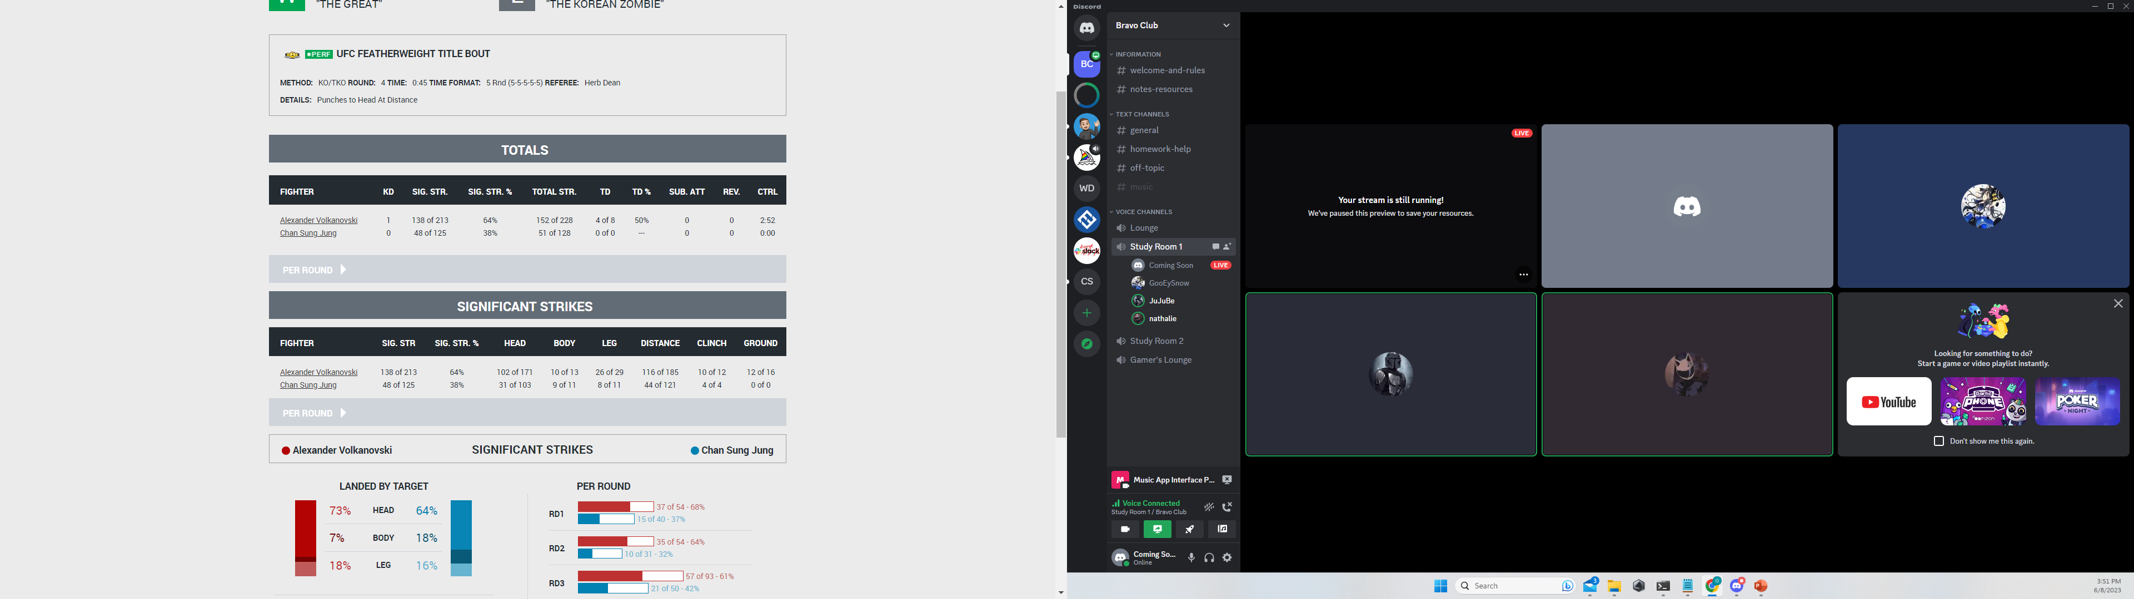

Predict Fight
Go to streamlit

Slide 22

Thank You !

